Slide 1


Cross-Sectional Surveys:
Inferring Total Eventual Time in Current State Using Only Elapsed Time-to-Date
Richard C. Larson
1.203J, 15.073J, IDS.700
November 15, 2017

Slide 2
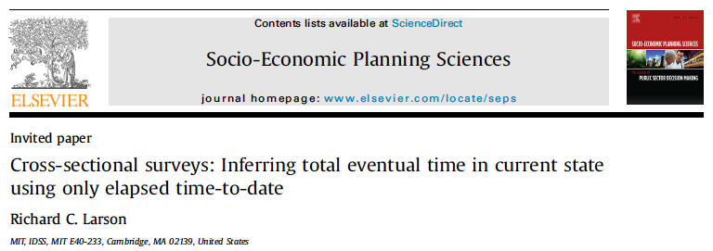
This material is “cultural enrichment!

Slide 3
Cross-Sectional Surveys
Focus: snapshot surveying populations whose members are in a temporary state such as being employed as post-docs.
See Fig. 1, as applied to post-docs.

Slide 4
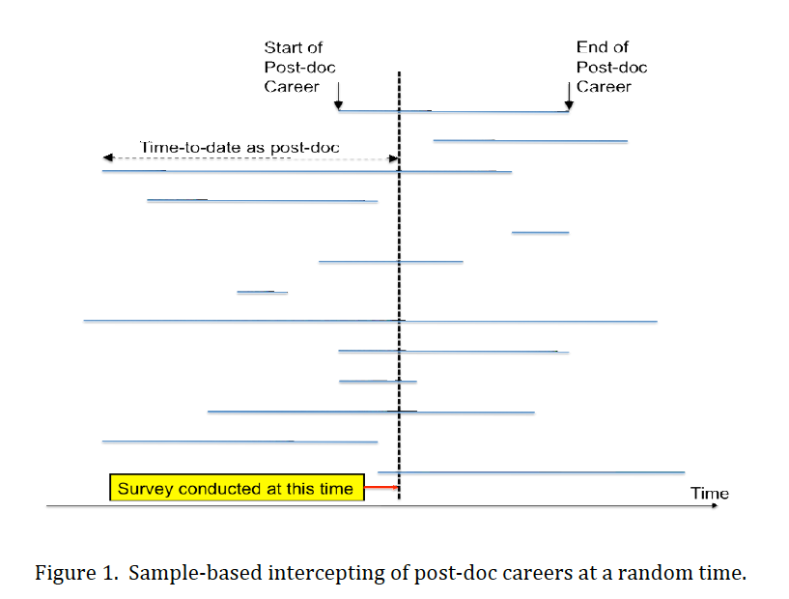

Slide 5
Applications
Post-doc career lengths
Criminal career durations
Queue waits for U.S. Veterans to VA services
Career lengths of any given vocation
Durations of home ownership
Duration of any given disease

Slide 6
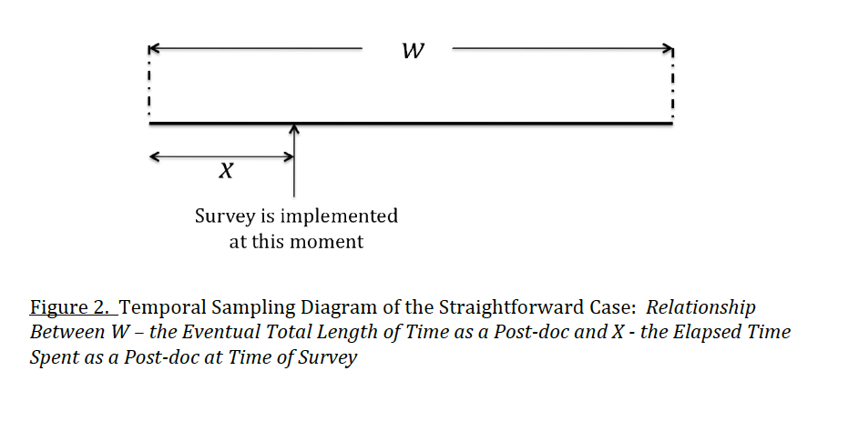

Slide 7

The Key Question:
Can we infer from these reported elapsed times (sampled values for X) the distribution of total time W that post-docs spend in the post-doc status?
If Yes, we have a substitute for “longitudinal surveys”

Slide 8
Cross-Sectional Surveys
One question asked: time already spent in the temporary state.
We develop mathematical procedures to estimate the distribution of total time that will eventually be spent in that state by a random individual who enters that state.
Post-docs leave that state either for a tenure-track faculty position or for some other position.

Slide 9
Cross-Sectional Surveys
Method relies on a selection bias often found in temporal sampling, sometimes called “random incidence” or “longevity bias.”
Also see Ed Kaplan, “Snapshot samples.” Socio-Economic Plan Sci 1997;31(4): 281-291.
Results for several types of sampling:
  Random and fixed times of surveying,
  Random and fixed times of entering the state, and
  Sampling only those who have already spent some minimal specified time in the targeted state

Slide 10
Random variable X = the elapsed post-doc time to date of the sampled post-docs
W = post-doc career duration
Usually we know about W and want to know about X. Here it is the reverse!
The key observation is this: The probability that any particular post-doc will be interviewed is directly proportional to two quantities:
  (1) the relative frequency of post-docs whose career duration W is in a specified incremental window and
  (2) the post-doc’s total career time W as a post-doc.

Slide 11


Slide 12
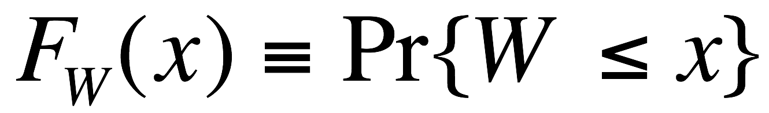
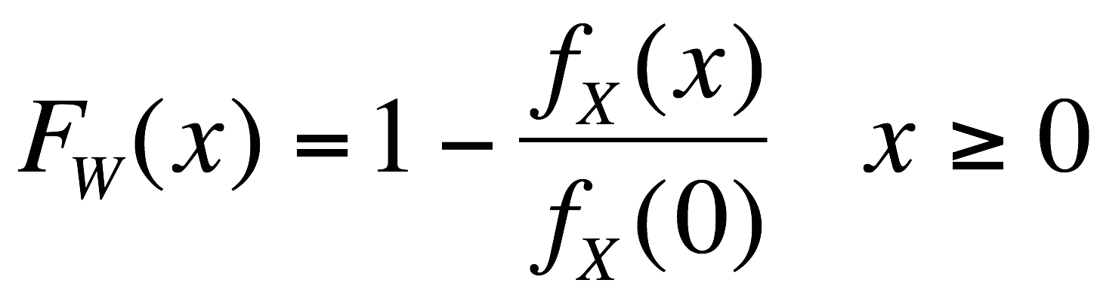
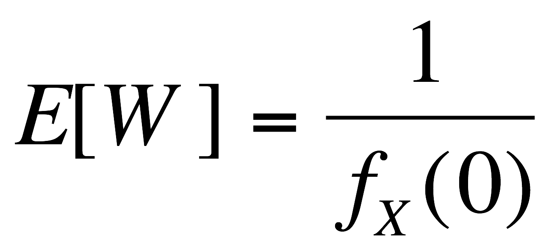
Eq. (4)
We have an empirical histogram for X, from our surveys.
We normalize it, keeping its shape, to get a Prob. Density Function.
This gives us valuable information about W:

Slide 13
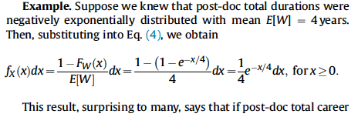

Slide 14

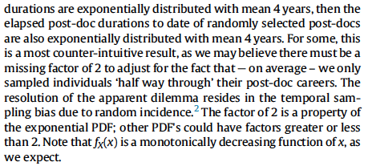

Slide 15
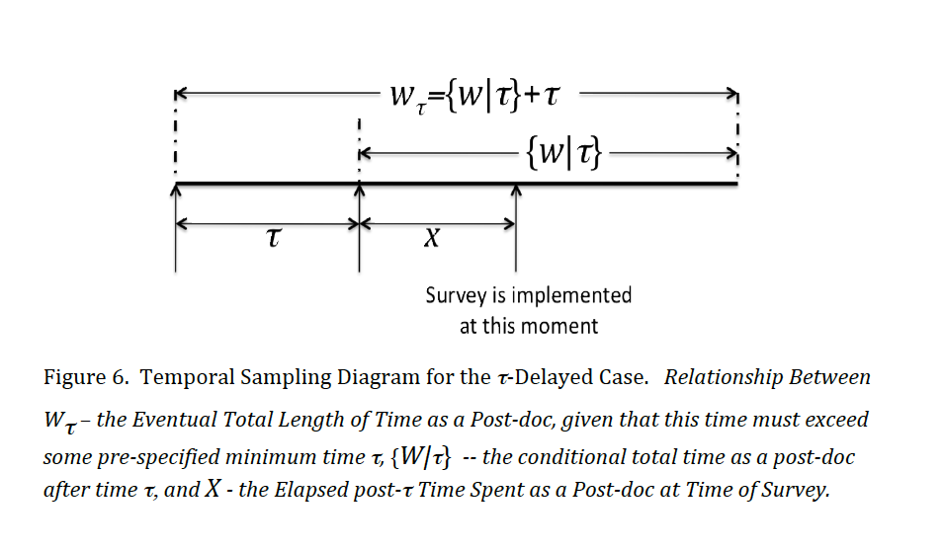
The Delay Case

Slide 16
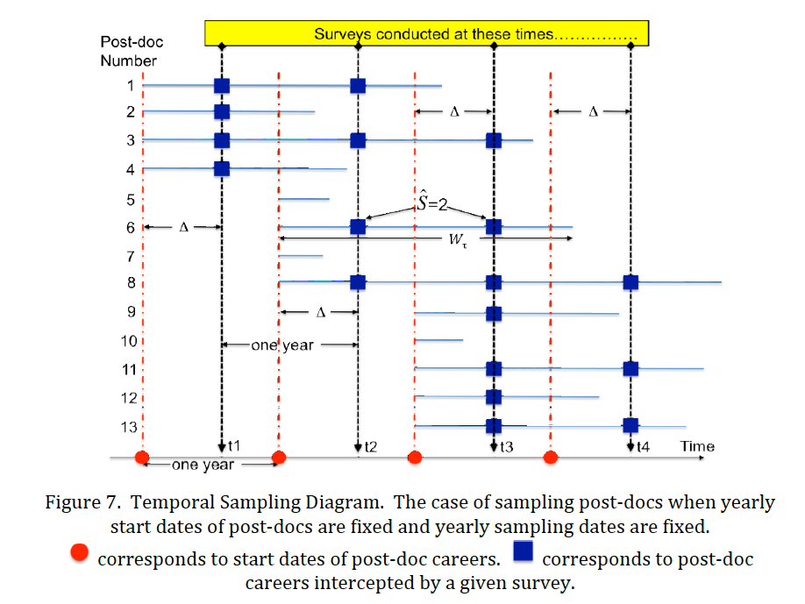

Slide 17
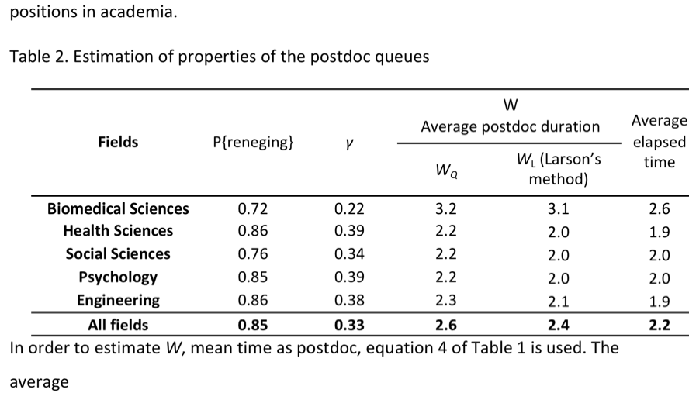
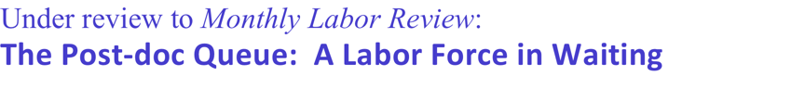

Slide 18

Thank You!
Dick Larson

